Slide 1
UCAS and apprenticeships
Elthorne park high school SIXTH FORM

Slide 2
Agenda
Plan of year between now and the end of term
AS results day
- Deadlines and personal statements
“Apply” booklet
What to do during the summer holidays
How can parents/carers help?
Apprenticeships

Slide 3
During the summer term
Registration on the UCAS website from 25th May 2016
All students will be researching university courses further
All students are encouraged to apply
Teachers will be writing the school reference
Work experience – the last two weeks of term if required. If none is required, students will attend lessons as normal
Personal statements will be written
Monday 13th and Tuesday 14th June will be UCAS days – no timetabled lessons.

Slide 4
Between half term 5 and end of academic year
All A-Level students will return (Monday 13th June) and begin A2 courses in all subjects
Students won’t be allowed to drop courses at this stage as results are unknown
BTEC work is ongoing – no study leave
Students encouraged to visit as many university open days as possible
Information on university open days can be found on the Elthorne Sixth Form website http://elthornesixthform.weebly.com
Monday 13th and Tuesday 14th June will be UCAS days – no timetabled lessons.

Slide 5
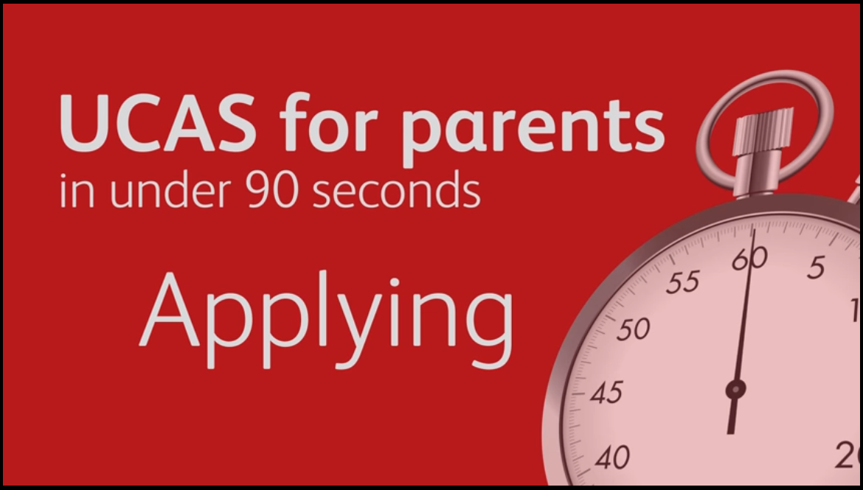
Year 12 next steps summer 2016

Slide 6
Agenda
Plan of year between now and the end of term
AS results day
Deadlines and personal statements
“Apply” booklet
What to do during the summer holidays
How can parents/carers help?
Apprenticeships

Slide 7
AS Results day – REACHED TARGET GRADES.
Results out on August 18th
If students have met their minimum target grade (MTG) they will complete their enrolment form into Year 13
Opportunity to inform us of which subjects they would like to drop → most students continue with three full A Levels.
Students are allowed to continue with all four, however this has to be agreed with Ms Wells
Ensure A2 work is complete for September
On holiday?
Students need to nominate (in writing) someone to pick up their results. We can post but only if s/he provides a SAE.

Slide 8
AS Results day – FAILED TO MEET GRADE BUT ACHIEVED MINIMUM of 3 “D” Grades
Make an appointment with Ms Wells to see if you can continue into Year 13
Appointment must be made on results day or the following Friday

Slide 9
AS Results day – FAILED (ACHIEVED LOWER THAN 3 “D” Grades
Students unable to continue onto Year 13
Only allowed to re-start Year 12 in special circumstances
Some can continue onto Year 13, but resit some of Year 12 units
Made complicated by recent changes in A Level courses → students will not gain same amount of support that others had in the past
Year 13 students won’t just be able to go into Year 12 classes for additional support

Slide 10
Agenda
Plan of year between now and the end of term
AS results day
Deadlines and personal statements
“Apply” booklet
What to do during the summer holidays
How can parents/carers help?
Apprenticeships

Slide 11
DEADLINES AND PERSONAL STATEMENTS - SEPTEMBER 2016
Students must return with a complete personal statement tailored to the subject of their choice (students should go through about 6 – 10 drafts of personal statement
Tutors will check and advise
Early entry – 15th October 2016 → Oxbridge, medicine, dentistry and veterinary science
Main deadline 2nd December 2016
UCAS deadline – 15th January 2017 → We need time to add a school reference and predicted grads. Miss the school deadline and we can not guarantee a reference in time.

Slide 12
WRITING A PERSONAL STATEMENT

Slide 13
Agenda
Plan of year between now and the end of term
AS results day
Deadlines and personal statements
“Apply” booklet
What to do during the summer holidays
How can parents/carers help?
Apprenticeships

Slide 14
APPLY BOOKLET

Slide 15
Agenda
Plan of year between now and the end of term
AS results day
Deadlines and personal statements
“Apply” booklet
What to do during the summer holidays
How can parents/carers help?
Apprenticeships

Slide 16
DURING THE SUMMER Holiday
A2 work
Ongoing BTEC work
Work experience to help their university application
Open days
Complete an online course (e.g. TEFL, Future Learn)

Slide 17
UNIVERSITY OPEN DAYS

Slide 18
Agenda
Plan of year between now and the end of term
AS results day
Deadlines and personal statements
“Apply” booklet
What to do during the summer holidays
How can parents/carers help?
Apprenticeships

Slide 19
HOW CAN I Help?
Ensure university choices are realistic and attainable → N.B the predicted grades are going to be the AS grades unless in exceptional circumstances
Entry requirements are spread above and below the predicted grades
Read personal statement drafts
Finance

Slide 20
Reasons why students may not want to go to university
“I can’t be bothered to write another essay”
“I want to earn money and not get in debt”
“I want to travel and think about university when I get back”

Slide 21
Living costs

Slide 22
Agenda
Plan of year between now and the end of term
AS results day
Deadlines and personal statements
“Apply” booklet
What to do during the summer holidays
How can parents/carers help?
Apprenticeships

Slide 23
NOT APPLYING TO UNIVERSITY OR NOT SURE?
The apprenticeship group begins in September led by Ms Barker, Connexions advisor.
There is an online process similar to UCAS
Vacancies tend to be published in February
We encourage students to keep ALL options open for as long as possible
https://www.findapprenticeship.service.gov.uk/apprenticeshipsearch

Slide 24
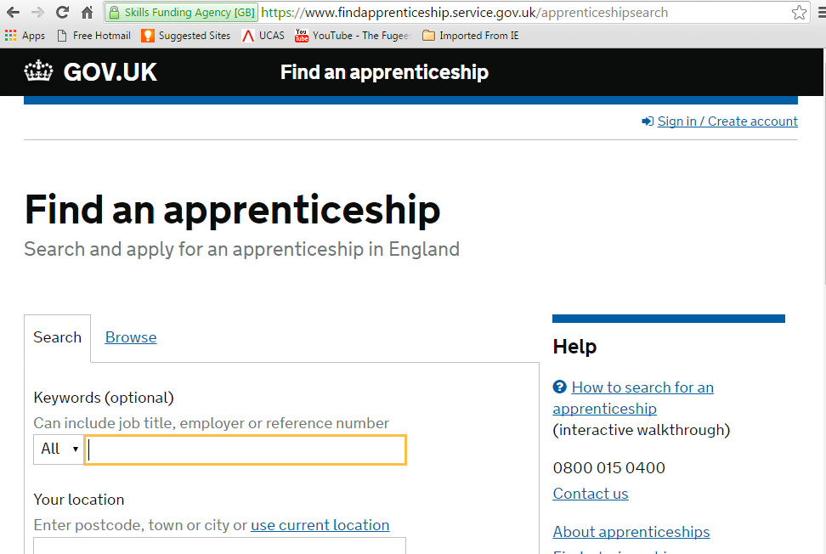
Key information sources
http://elthornesixthform.weebly.com/
www.ucas.com
https://www.findapprenticeship.service.gov.uk/apprenticeshipsearch

